Slide 1
John Brzezinski
john.richard.brzezinski@gmail.com
574-850-2505
Data Engineer Application

Slide 2
Finding the data
Exploratory research to find source data
Single source would be optimal to reduce coding requirements
Successfully found www.transfermarkt.com

Slide 3
Researching the HTML
Reviewed the HTML source code to determine how to access data
Determining if Python/Requests would be sufficient or if Python/Selenium would be required.
Through testing, Python/Request was found to be sufficient

Slide 4
Coding – Python - Scraping
I used a simple coding environment
  Python
    Requests, Pandas, SQLite3, Beautifulsoup, json, time, Numpy
2 URLs for the team data, 20 URLs for the player data had to be scrapped.
HTML and data structures were the same for all URLS making for easy data access

Slide 5
Coding – Python - Database
For simplicity and ease of replication, I used SQLite3 with an in-memory database
Python was used to create 2 tables – team, player – that would hold all of the scraped data
Python was used to send the SQL query used as my solution

Slide 6
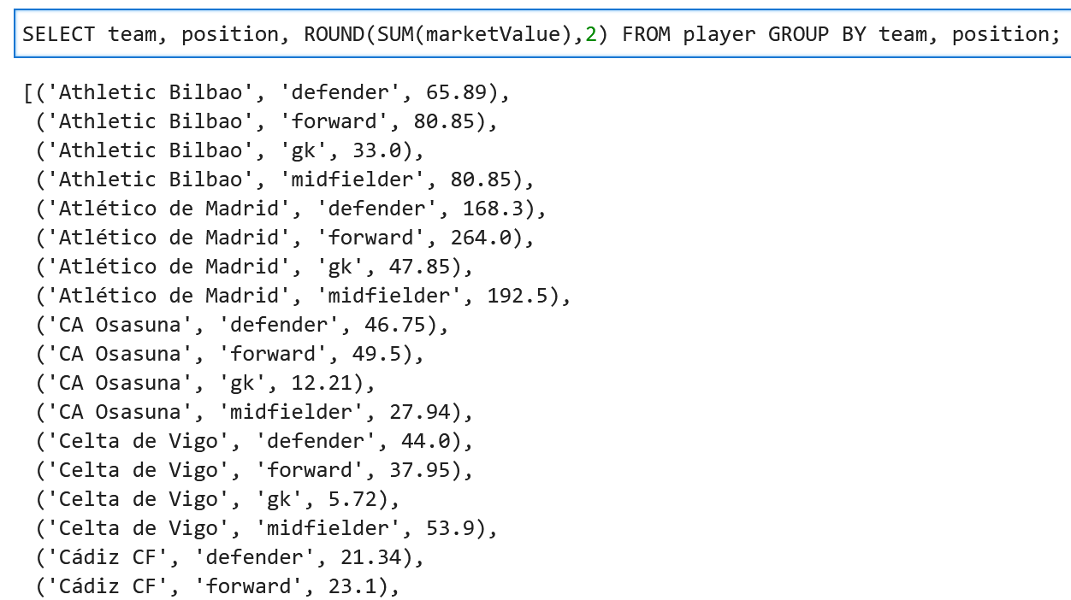
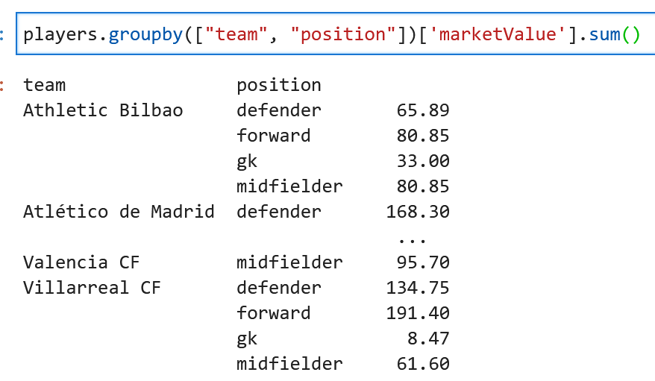
Solution Sample
SQL query results sample
Pandas solution sample

